Slide 1
Adder

Slide 2
آزمون ميان ترم
چهارشنبه 10 آذر، ساعت 12 تا 13:30
کتبی: courses + نیما
شفاهی: اسکایپ

Slide 3
Half Adder (HA)
Add single bits
Ai
Bi
Sum
Carry
0
0
0
0
0
1
1
0
1
0
1
0
1
1
0
1

Slide 4
Half Adder (HA)
Add single bits
Ai
0
1
Ai
0
1
Ai
Bi
Sum
Carry
Bi
Bi
0
0
0
0
0
0
1
0
0
0
0
1
1
0
1
0
1
0
1
1
0
1
0
1
1
1
0
1
Sum = Ai Bi + Ai Bi
Carry = Ai . Bi
= Ai⊕Bi

Slide 5
Full Adder
Add multiple bits

Slide 6
Full Adder (FA)
A B
A
B
C_{I}
S
C_{O}
C_{I}
00
01
11
10
0
0
0
0
0
0
0
1
0
1
0
0
1
1
0
S
0
1
0
1
0
1
1
0
1
0
0
1
1
0
1
1
0
0
1
0
1
0
1
0
1
A B
1
1
0
0
1
C_{I}
00
01
11
10
1
1
1
1
1
0
0
0
1
0
C_{O}
S = C_{I} xor A xor B
C_{O} = B C_{I} + A C_{I} + A B = C_{I} (A + B) + A B
1
0
1
1
1
A
A
B
B
CI
CO
S
CI
A
B

Slide 7
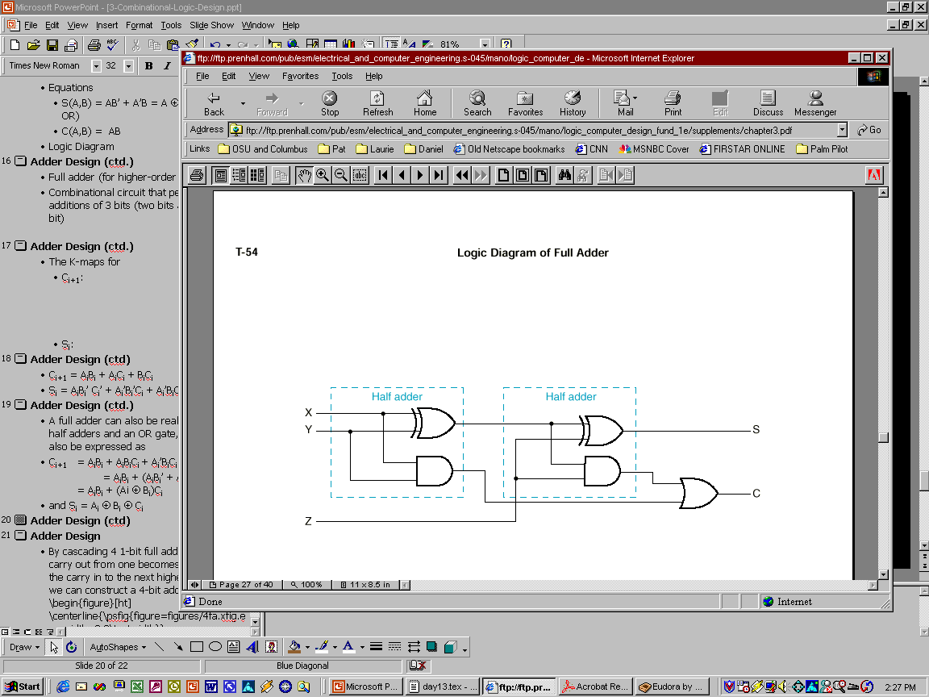
Full Adder Using 2 Half Adders
A full adder can also be realized with two half adders and an OR gate, since C_{i+1} can also be expressed as:
C_{i+1} = A_{i}B_{i} + (Ai ⊕ B_{i})C_{i}
and S_{i} = (A_{i} ⊕ B_{i}) ⊕ C_{i}
A_{i}
B_{i}
S_{i}
C_{i+1}
C_{i}

Slide 8
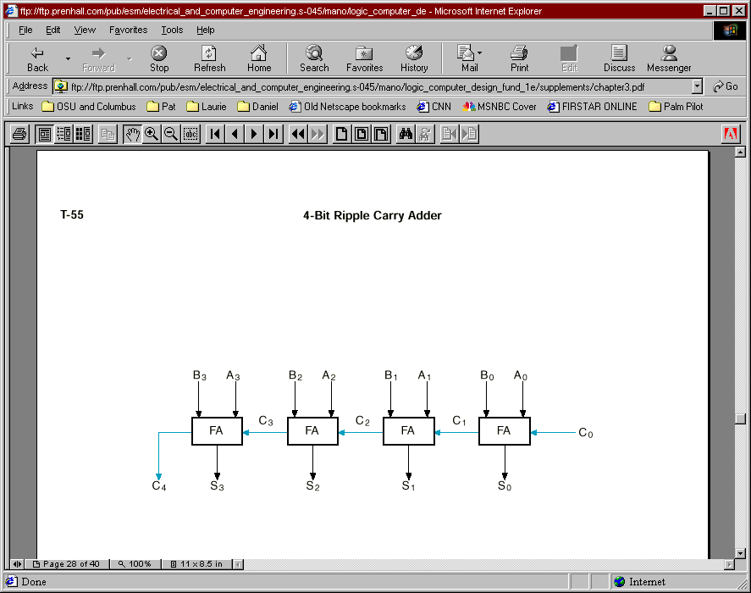
Example: 4-bit Ripple Carry Adder
C₄ C3 C2 C1 C0 A3 A2 A1 A0 +B3 B2 B1 B0 -------------- S3 S2 S1 S0

Slide 9
Delay Analysis of Ripple Adder
Carry out of a single stage can be implemented in 2 gate delays after CI is ready.
A
A
B
B
CI
CO
S
CI
A
B
For a 16 bit adder, the 16th bit carry is generated after about 16 * 2 = 32 gate delays.
The sum bit takes one additional gate delay to generate the sum of the 16th bit after 15th bit carry
~ 15 * 2 + 1 = 31 gate delays
Takes too long - need to investigate FASTER adders!

Slide 10
Ripple Carry Adder Delay Analysis
late
arriving
signal
@0
A
@1
@t+1
@0
A
@0
B
@0
@t
CI
CO
B
S
@0
A
@t+2
@t
CI
@t+1
@0
B
@1

Slide 11
Ripple Carry Adder Delay Analysis
late
arriving
signal
@0
A
@1
@t+1
@0
A
@0
B
@0
@t
CI
CO
B
S
@0
A
@t+2
@t
CI
@t+1
@0
B
@1
late
arriving
signal
@0
A
@1
@t+1
A
@0
B
B
@t
CI
CO
CO
@0
A
CI
B
A
@0
@1
B

Slide 12
Ripple Carry Adder Delay Analysis
late
arriving
signal
@0
A
@1
@t+1
@0
A
@0
B
@0
@t
CI
CO
B
S
@0
A
@t+2
@t
CI
@t+1
@0
B
@1
@0
@0
@0
@0
@0
@0
@0
@0
@0
@9
@7
@5
@3
@4
@2

Slide 13
Carry Lookahead Adder
Carry Generate
Gi = Ai Bi must generate carry when A = B = 1
Carry Propagate
Pi = Ai xor Bi carry-in will equal carry-out here
Sum and Carry can be reexpressed in terms of generate/propagate:
S_{i} = Ai xor Bi xor Ci = Pi xor Ci
C_{i+1} = Ai Bi + Ai Ci + Bi Ci
= Ai Bi + Ci (Ai + Bi)
= Ai Bi + Ci (Ai xor Bi)
= Gi + Ci Pi

Slide 14
Carry Lookahead Adder
C1 = G0 + P0 C0
C2 = G1 + P1 C1
= G1 + P1 (G0 + P0 C0)
= G1 + P1 G0 + P1 P0 C0
C3 = G2 + P2 C2
= G2 + P2 (G1 + P1 G0 + P1 P0 C0)
= G2 + P2 G1 + P2 P1 G0 + P2 P1 P0 C0
C4 = G3 + P3 C3
= G3 + P3 G2 + P3 P2 G1 + P3 P2 P1 G0 + P3 P2 P1 P0 C0
Each of the carry equations can be implemented in a two-level logic network
Variables are the adder inputs and carry in to stage 0!

Slide 15
CLA
@0
Ai
@0
Bi
Pi
@1
Ci
Si
@t+1
@t
Gi
@1
C0
C0
C0
P0
C1
P0
P0
G0
P1
P1
P2
P2
G0
P3
C0
P1
G0
P0
P2
P1
P1
P2
G1
C3
P3
G0
C2
P2
G1
P1
P2
G2
P3
G1
G2
C4
P3
G3
Increasingly complex logic

Slide 16
Ripple Carry Adder Delay Analysis
@0
C0
P0
@0
P1
Ai
Pi
@1
@0
P2
Bi
@1
G0
Ci
Si
@t+1
P1
@t
P2
G1
C3
Gi
@1
P2
G2
@0
@0
@0
@0
@0
@0
@0
@0
@0
@3
@3
@3
@3
@4
@4
@4
@2

Slide 17
Delay Analysis of CLA
NOTE: This assumes all gate delay are same.
Not true, delays depend on fan-ins and fan-out

Slide 18
Cascaded CLA
CLA
CLA
CLA

Slide 19
Adder/Subtractor
A - B = A + (-B) = A + B’ + 1
A
B
A
B
A
B
A
B
3
3
2
2
1
1
0
0
A
B
A
B
A
B
A
B
CO
+
CI
CO
+
CI
CO
+
CI
CO
+
CI
Add/Subtract
S
S
S
S
S
S
S
S
3
2
1
0
Overflow

Slide 20
Adder/Subtractor
A - B = A + (-B) = A + B’ + 1

Slide 21
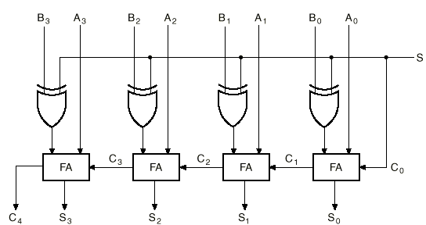
4-bit Binary Adder/Subtractor (cont.)
S=0
B₃
B₂
B₁
B₀
0
S=0 selects addition

Slide 22
4-bit Binary Adder/Subtractor (cont.)
S=1
B₃’
B₂’
B₁’
B₀’
1
S=1 selects subtraction

Slide 23
Overflow
Overflow can occur ONLY when both numbers have the same sign.
This condition can be detected when the carry out (C_{n}) is different than the carry at the previous position (C_{n-1}).

Slide 24
The Overflow problem in Signed-2’s Complement (cont.)
Example 1: M=65₁₀ and N=65₁₀ (In an 8-bit 2’s complement system).
M = N = 01000001₂
M+N = 10000010 with C_{n}=0. (clearly wrong!)
Bring C_{n} as the MSB to get 010000010₂ (130₁₀) which is correct, but requires 9-bits → overflow occurs.
Example 2: M=-65₁₀ and N=-65₁₀
M = N = 10111111₂
M+N = 01111110 with C_{n}=1. (wrong again!)
Bring C_{n} as the MSB to get 101111110₂ (-130₁₀) which is correct, but also requires 9-bits → overflow occurs.

Slide 25
Overflow Detection in Signed-2’s Complement
V
C_{n-1}
C_{n}
C
n-bit Adder/Subtractor
C =1 indicates overflow condition when adding/subtr. unsigned numbers.
V=1 indicates overflow condition when adding/subtr. signed-2’s complement numbers

Slide 26
2x2-bit Multiplier
A2 A1 B2 B1 P8 P4 P2 P1
0 0 0 0 0 0 0 0
0 1 0 0 0 0
1 0 0 0 0 0
1 1 0 0 0 0
0 1 0 0 0 0 0 0
0 1 0 0 0 1
1 0 0 0 1 0
1 1 0 0 1 1
1 0 0 0 0 0 0 0
0 1 0 0 1 0
1 0 0 1 0 0
1 1 0 1 1 0
1 1 0 0 0 0 0 0
0 1 0 0 1 1 1 0 0 1 1 0
1 1 1 0 0 1
A1
A2 B1
B2
P1
P2 P4
P8
4-variable K-map
for each of the 4
output functions

Slide 27
2x2-bit Multiplier (cont’d)
A2
A2
K-map for P8
K-map for P4
0 0
0 0
0 0
0 0
0 0
0 0
0 0
0 0
P4 = A2B2B1' + A2A1'B2
B1
B1
0 0
0 0
1 0
0 0
0 0
0 0
0 1
1 1
B2
P8 = A2A1B2B1
B2
A1
A1
A2
A2
K-map for P2
K-map for P1
0 0
0 0
0 0
1 1
0 0
0 1
0 0
1 0
P1 = A1B1
B1
B1
0 1
0 1
0 1
1 0
0 1
0 0
1 0
0 0
B2
P2 = A2'A1B2 + A1B2B1' + A2B2'B1 + A2A1'B1
B2
A1
A1

Slide 28
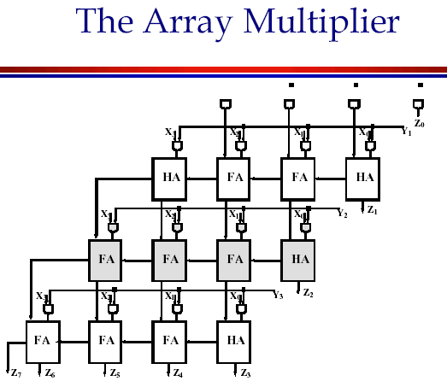

Multiplier
Y0
X3 Y3
X3 Y2
X2 Y3
X3 Y1
X2 Y2
X1 Y3
X3
Y3
X2 Y0
X2 Y1
X1 Y2
X0 Y3
X2
Y2
X2 Y0
X1 Y1
X0 Y2
X1
Y1
X1 Y0
X0 Y1
X0
Y0
X0 Y0
Z7
Z6
Z5
Z4
Z3
Z2
Z1
Z0

Slide 29
4-Bit ALU
74181 TTL ALU
Arithmetic-Logic Unit

Slide 30
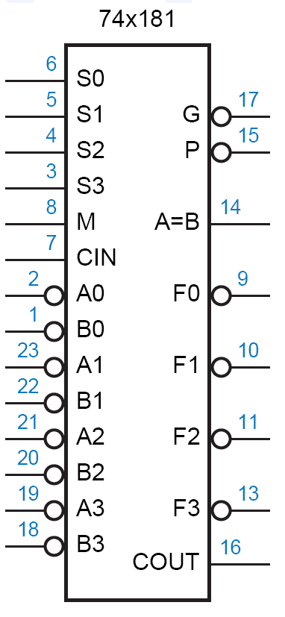
4-Bit ALU

Slide 31
BCD Addition
Addition:
5 = 0101
3 = 0011
1000 = 8
5 = 0101
8 = 1000
1101 = 13!
Problem
when digit
sum exceeds 9
Solution: add 6 (0110) if sum exceeds 9!
5 = 0101
8 = 1000
1101
6 = 0110
1 0011 = 1 3 in BCD
9 = 1001
7 = 0111
1 0000 = 16 in binary
6 = 0110
1 0110 = 1 6 in BCD

Slide 32
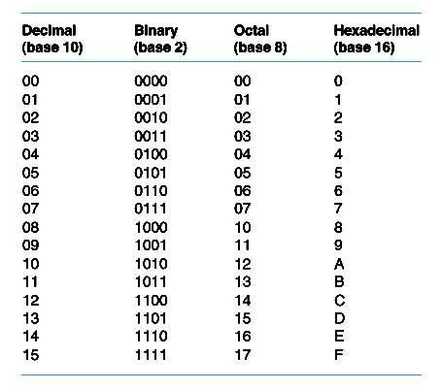
اعداد در مبناهاي مختلف
Add 0110 to sum whenever it exceeds 1001 (11XX or 1X1X)

Slide 33
BCD Adder
A
3
B
3
A
2
B
A
B
A
B
2
1
1
0
0
CO
F
A
CI
CO
F
A
CI
CO
F
A
CI
CO
F
A
CI
Cin
S
S
S
S
Cout
S
S
S
S
3
2
1
0
Add 0110 to sum whenever it exceeds 1001 (11XX or 1X1X)

Slide 34
BCD Adder
A
3
B
3
A
2
B
A
B
A
B
2
1
1
0
0
CO
F
A
CI
CO
F
A
CI
CO
F
A
CI
CO
F
A
CI
Cin
S
S
S
S
1
1XX
A1
1X1X
A2
CO
F
A
CI
CO
F
A
CI
0
S
S
Cout
S
S
S
S
3
2
1
0
Add 0110 to sum whenever it exceeds 1001 (11XX or 1X1X)

